Slide 1

Lecture Hall Management System
Team:
PM: RATHNAYAKE R.G.R.M.D.R. (2022/E/122)
QA & Design: MADUSHANKA W.N.L. (2022/E/167)
RA: RAJAPAKSHA K.G.M.S. (2022/E/080)
Developers: DE COSTA M.S.M. (2022/E/092) / SENARATHNA S.A.D.H.D. (2022/E/141)
Date: January 23, 2026

Slide 2
Project Overview
Problem & Objectives
The Problem:
Difficulty in quickly finding available lecture halls.
Students often miss crucial lecture announcements.
Booking conflicts and slow manual approval processes.
Our Objective:
Project Objective:
To develop a web-based Lecture Hall Management System that simplifies lecture hall booking, approval, timetable visibility, and notifications
Specific Objectives:
Enable lecturers to check availability and request lecture hall bookings.
Implement an HOD approval process to manage bookings.
Prevent booking conflicts through controlled scheduling.
Provide students with batch-wise timetable access.
Deliver timely notifications for approvals, updates, and cancellations.
Ensure the system is user-friendly, secure, and efficient through role-based access.

Slide 3
Confirmed Scope
Concurrent User Engagement
The system will efficiently handle simultaneous user interactions, ensuring real-time data synchronization and conflict-free operations
Lecture hall Bookings & Availability View
Lecturers can easily book available halls and quickly check hall availability.
Student Notifications
Students receive special lecture notices

Slide 4
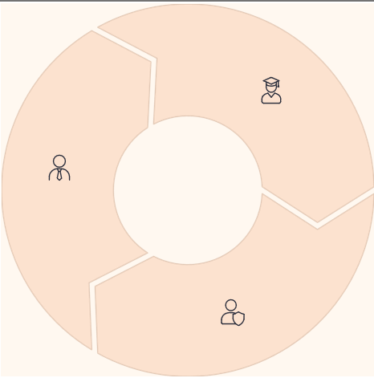
System Design
Users & Role-Based Access
Student
View timetables, receive notices.
Lecturer
Request bookings, post notices
Department Head (HOD)
Approve/reject bookings.
Future Scope: Technician roles for system management and user updates.

Slide 5
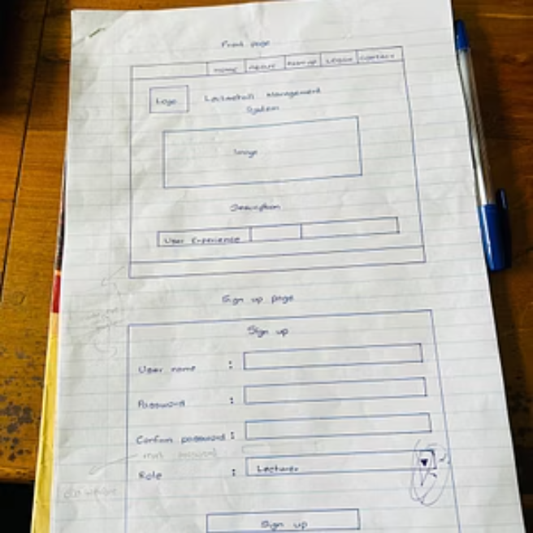
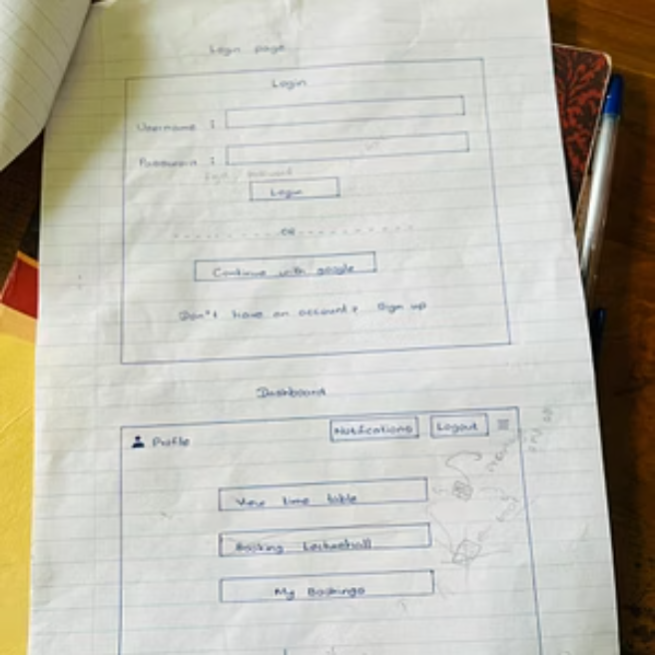
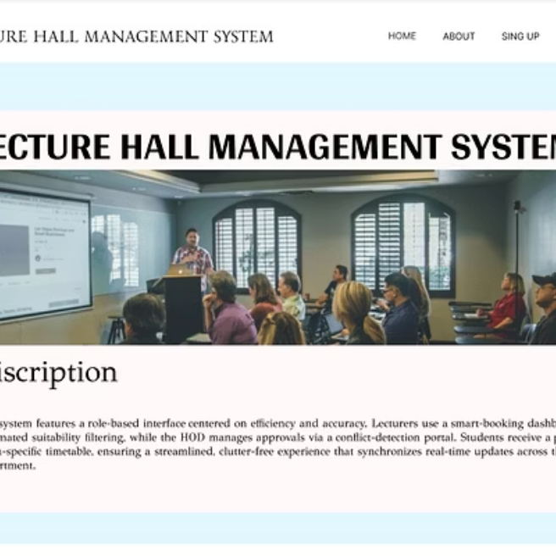
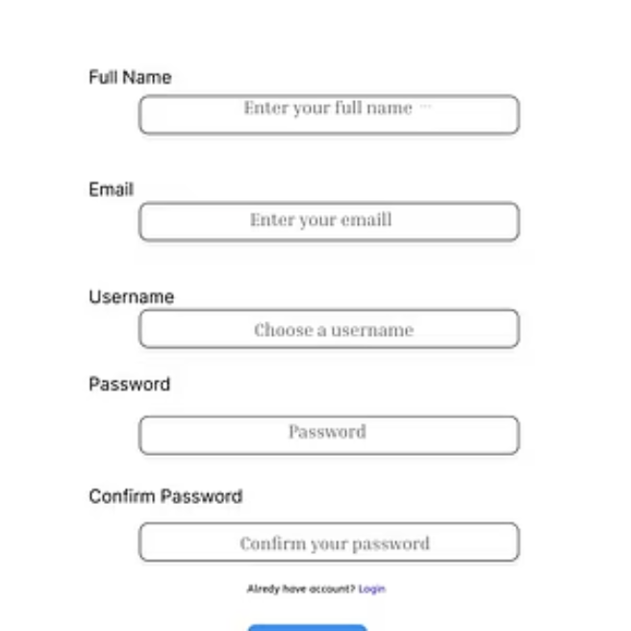
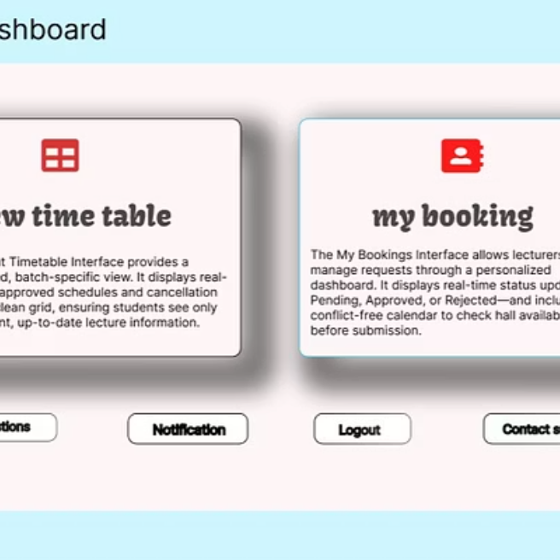
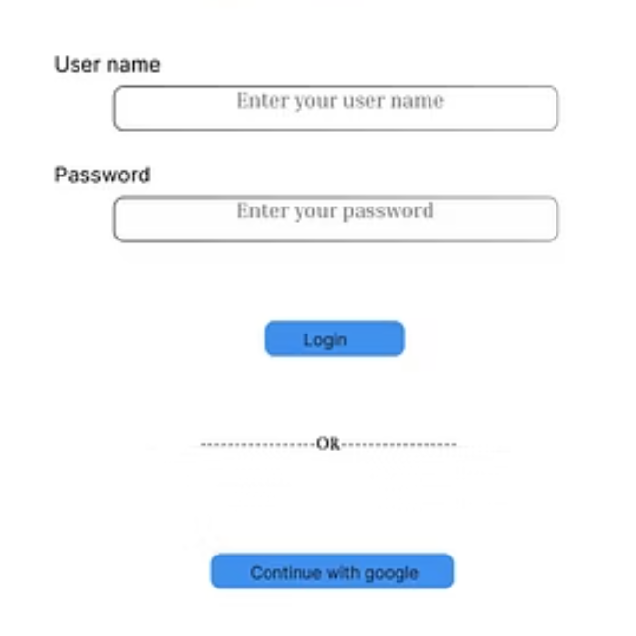
User Experience
Mock Design / UI-UX in Figma https://www.figma.com/design/wh9ZsOPlwbD0R1iOQ3k68n/LECTURE-HALL-DESIHN-1?node-id=0-1&m=dev&t=j9L7H6FyyaxNzYlk-1
We developed intuitive web UI mockups in Figma, integrating key user feedback for an optimal experience.

Slide 6
System Foundation
Functional Requirements
1
Search & Filter
Search and view hall availability with various filters.
2
Booking Requests
Lecturers submit detailed booking requests.
3
Approval Workflow
HODs approve/reject requests with clear reasons.
4
Conflict Prevention
System prevents double-booking of halls.
5
Notice Management
Lecturers post special notices; students receive notifications.

Slide 7
Technical Considerations
Non-Functional Requirements
Usability
Is booking/viewing intuitive for first-time users?
Are steps minimal with clear labels and status updates?
Performance
Does availability search respond within 2-3 seconds?
Can it handle peak-time usage without lag?
Security
Is authentication required for all key actions?
Is role-based access strictly enforced?
Data Storage
How large is the expected data store for bookings and timetables?
Environmental
Available hardware, network, power, and connectivity limitations?
Operational
Who manages the system and during what hours?

Slide 8
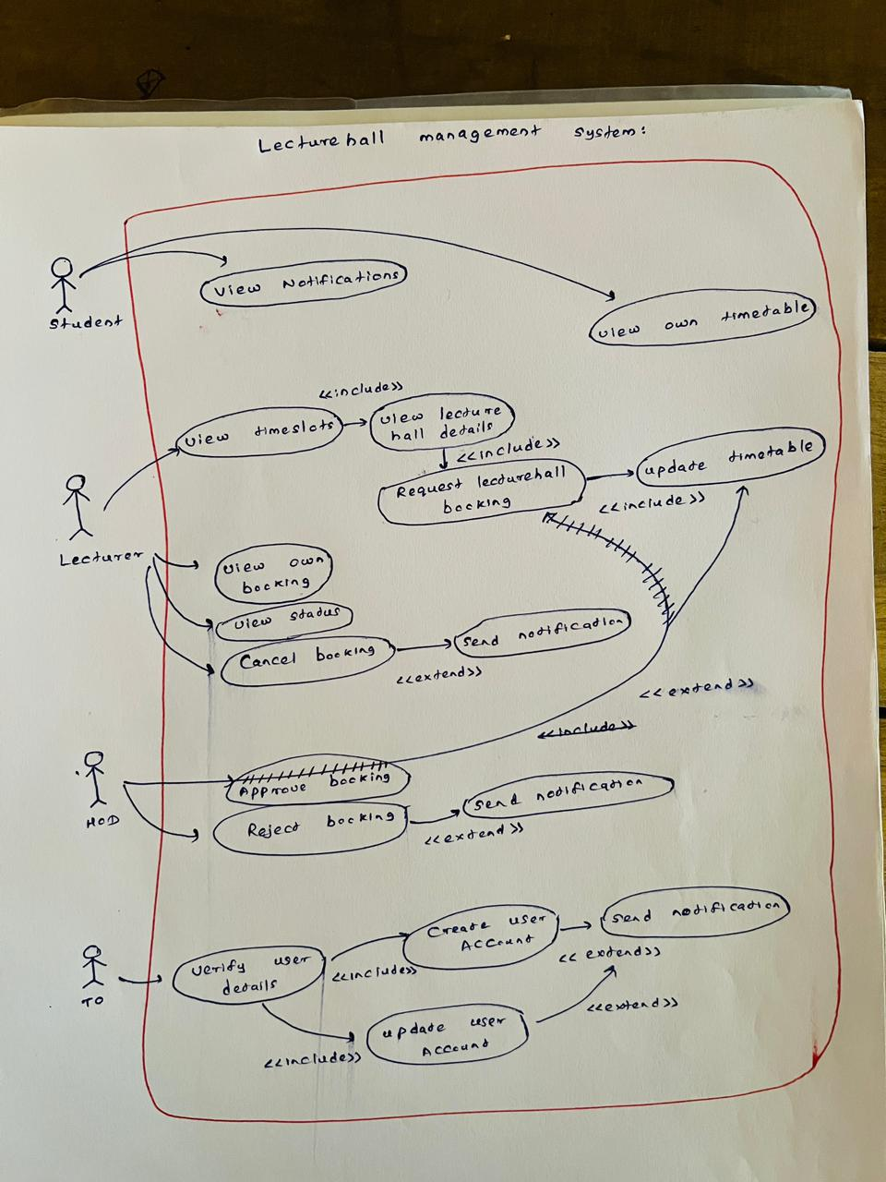
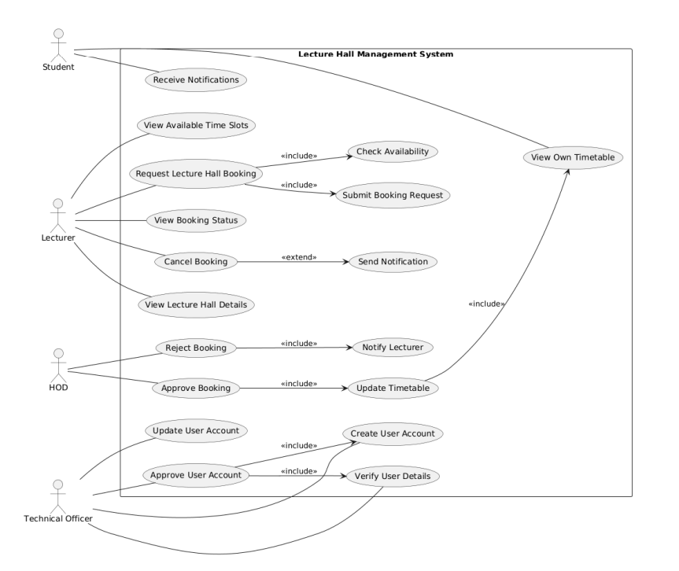
Use case diagram
First use case diagram After rechecking: use case diagram

Slide 9
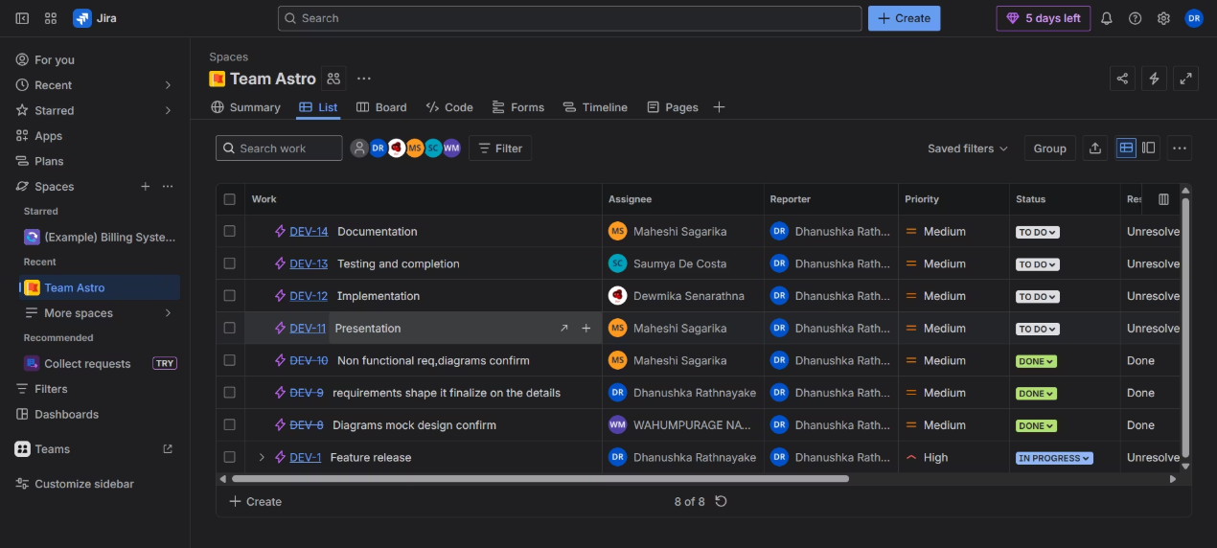
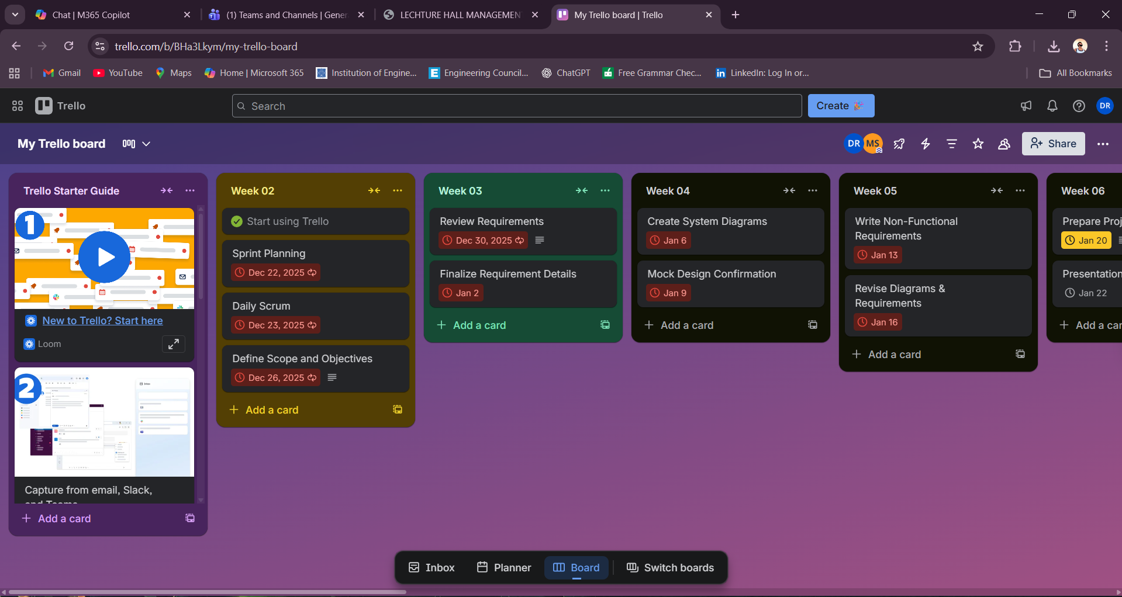
Project Management
Meetings & Workflow
PM Tool Handling
Main project management tool: Jira
Time boxing tool: trello
Backlog management and sprint task assignments
https://trello.com/invite/b/6965fcf4520e33971ed77323/ATTI73274ec242ff6c0e95df93b69aaf9dd3371C1464/my-trello-board
Clear workflow: To Do → In Progress → Review/QA → Done
https://lecturehallmanagement.atlassian.net/jira/software/projects/DEV/list?jql=project%20%3D%20DEV%20ORDER%20BY%20created%20DESC
Manage our project’s codebase, version control, and collaboration : GitHub
https://github.com/Dhanushka0626/Lecture-hall-management

Slide 10
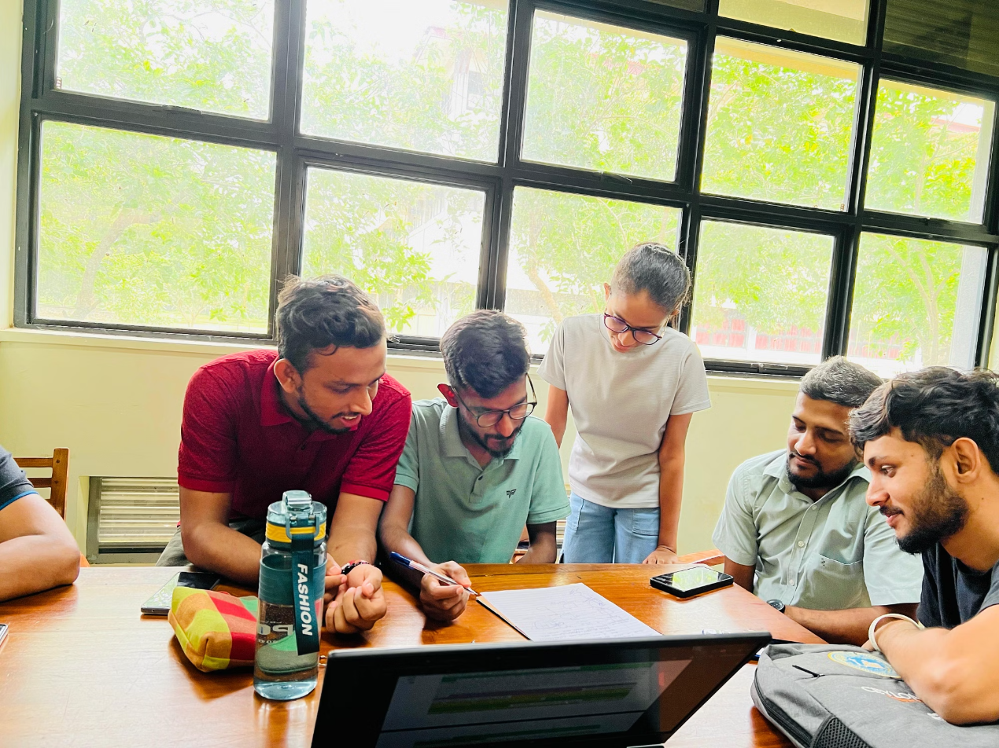
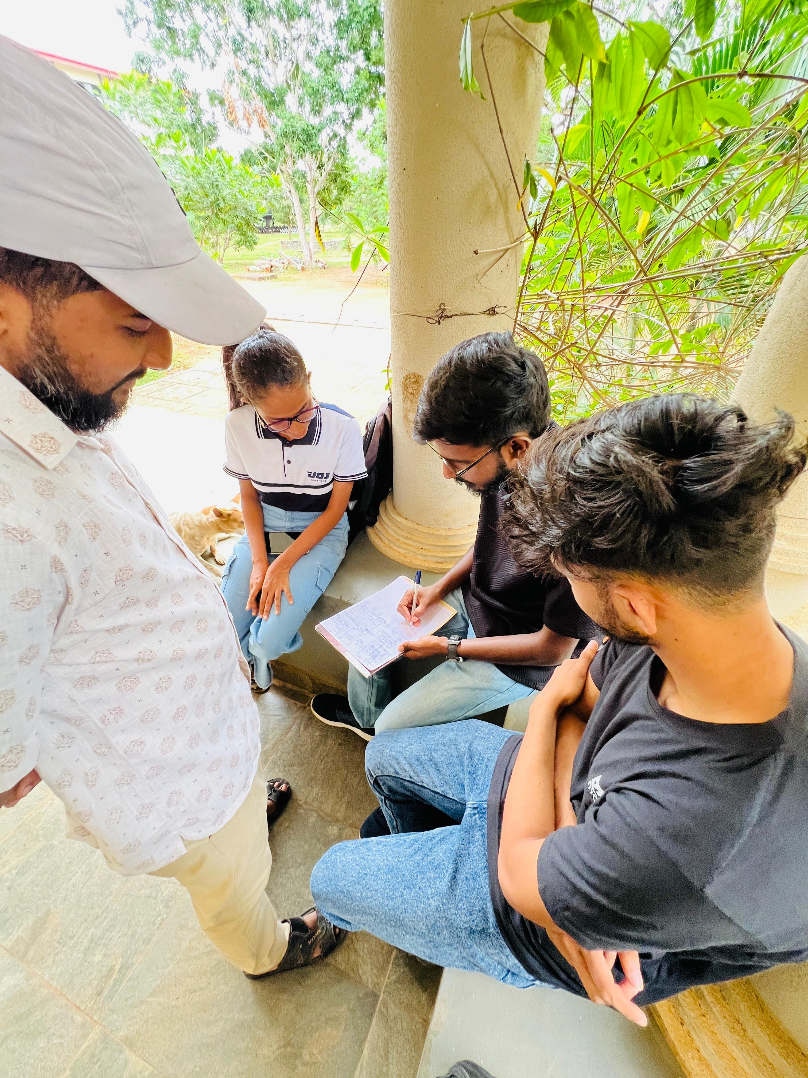
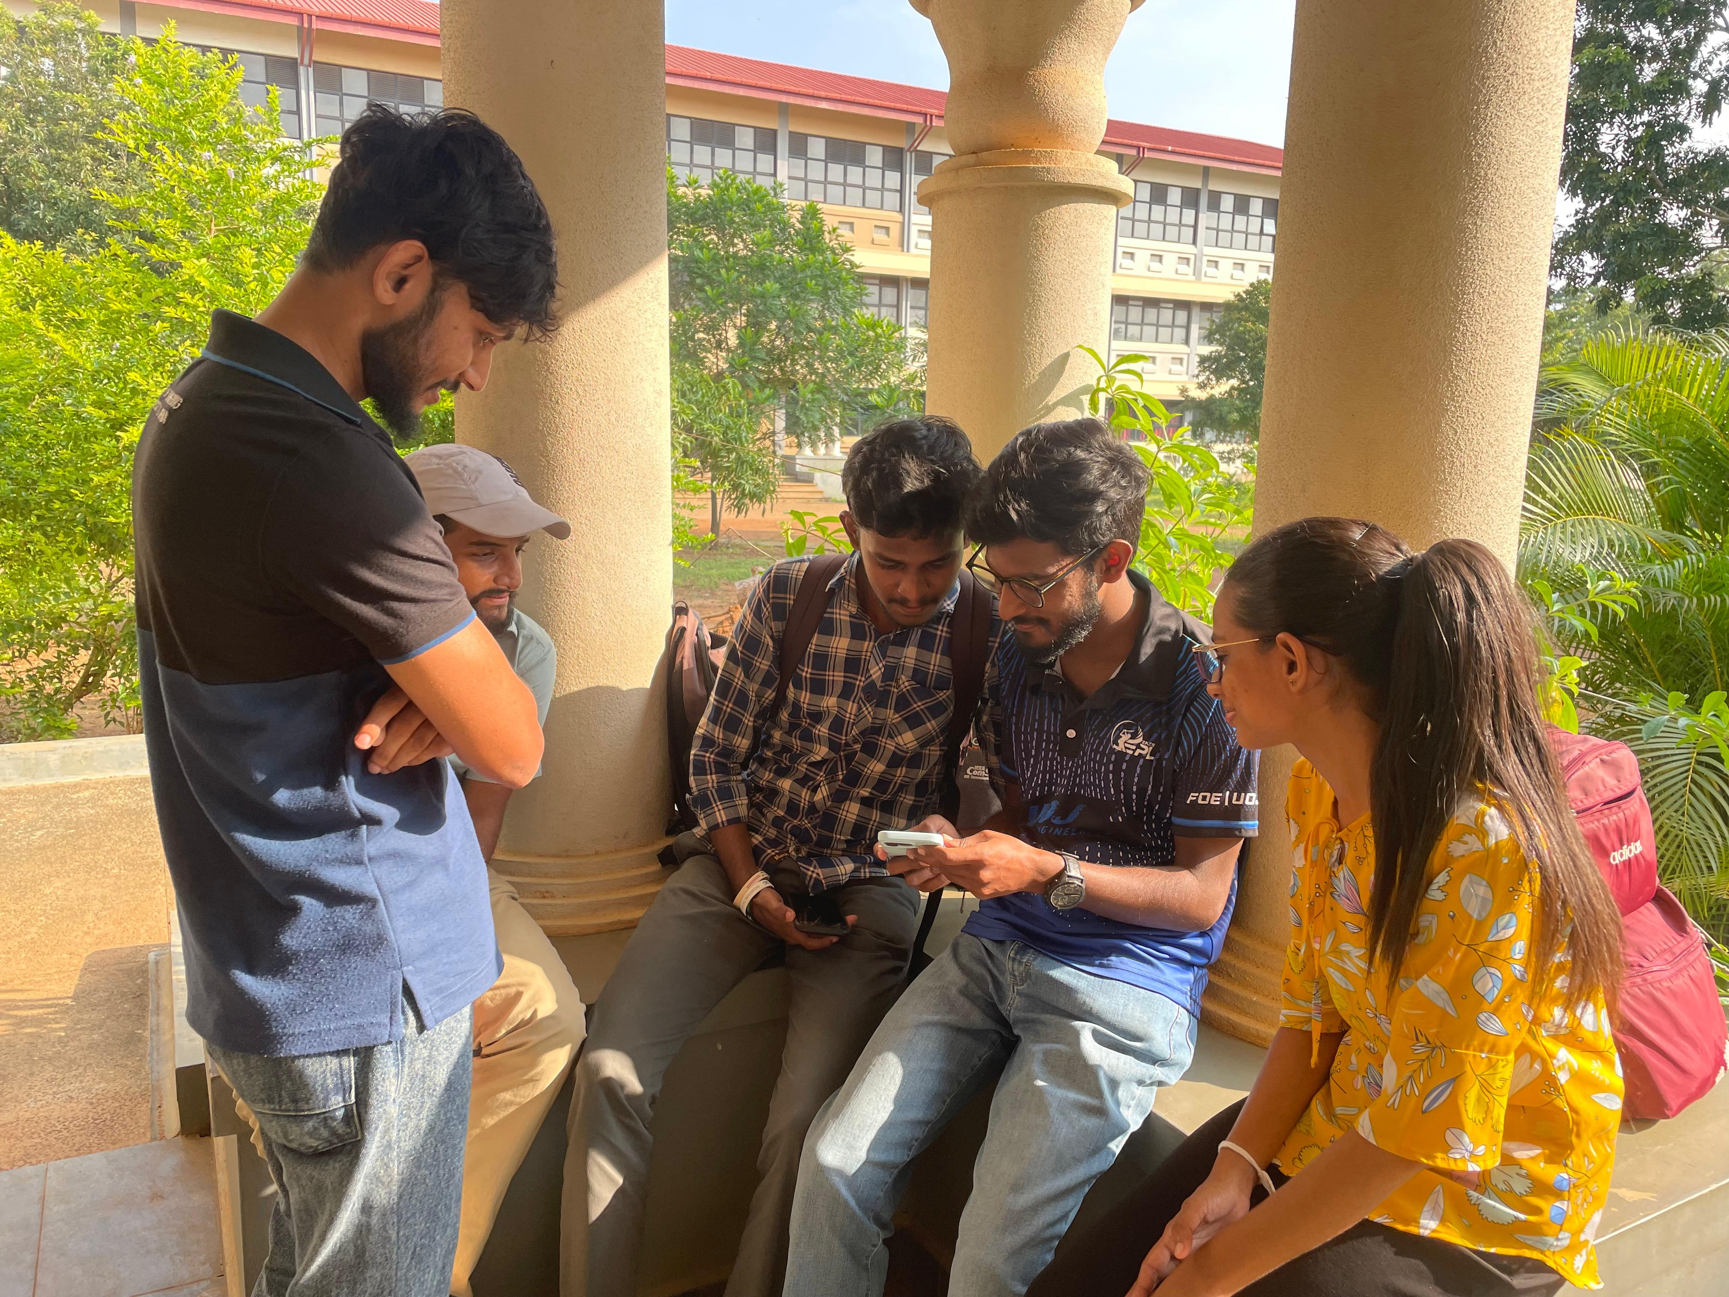
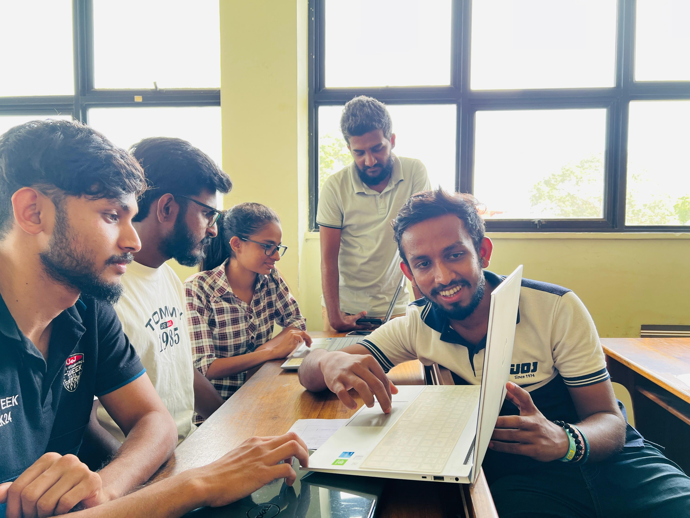
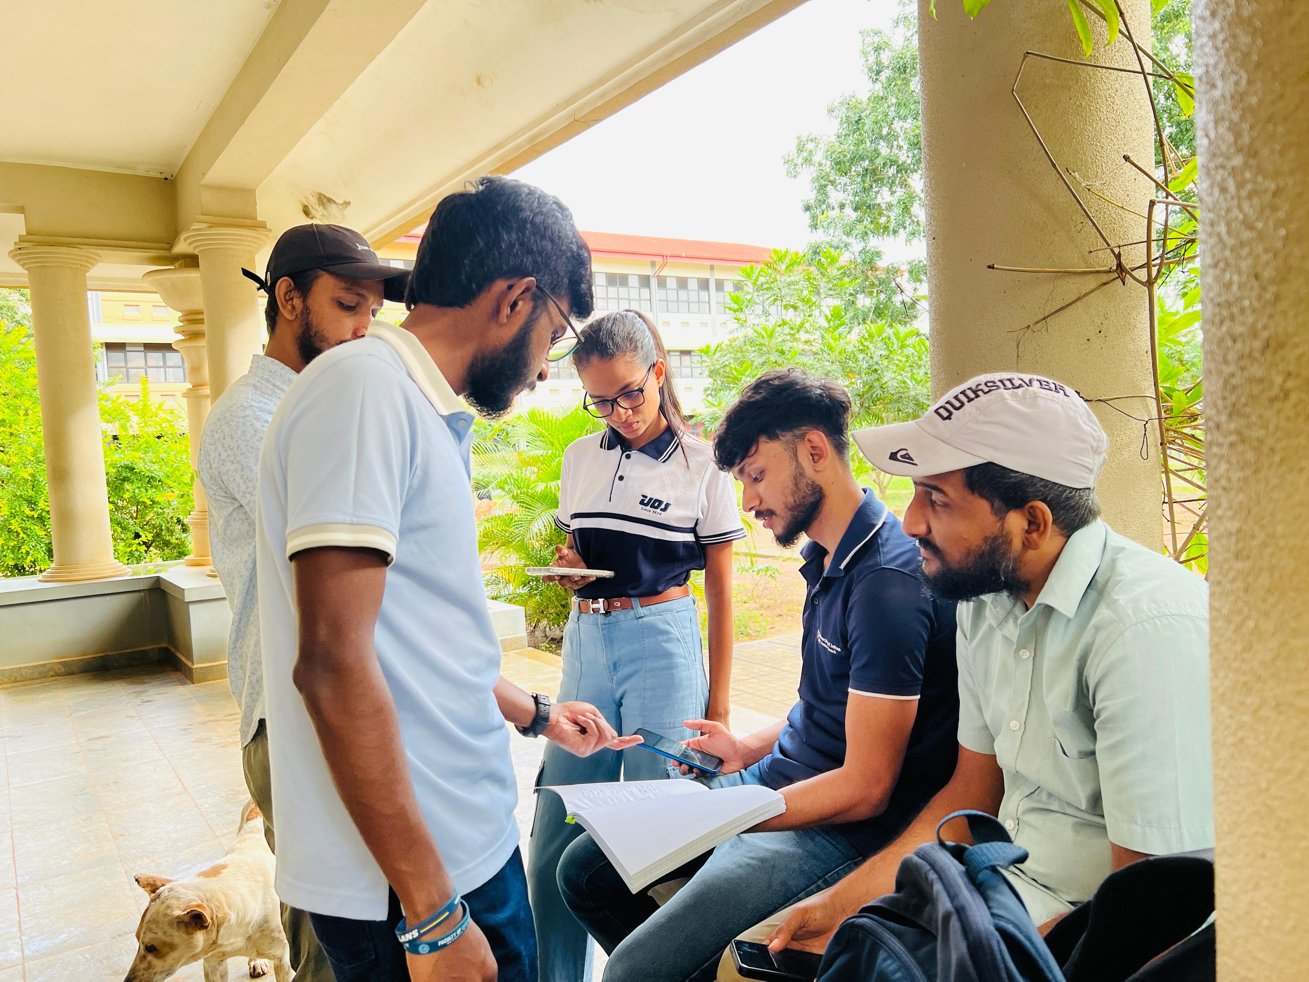
Key Meetings & Outcomes
Week 2: Lecturer & student discussions (requirements & UX feedback).
Week 3: Finalized scope and Figma mockups completed.
Week 4: Use case diagram & NFR questions finalized.
Regular short client/user check-ins were also conducted.

Slide 11
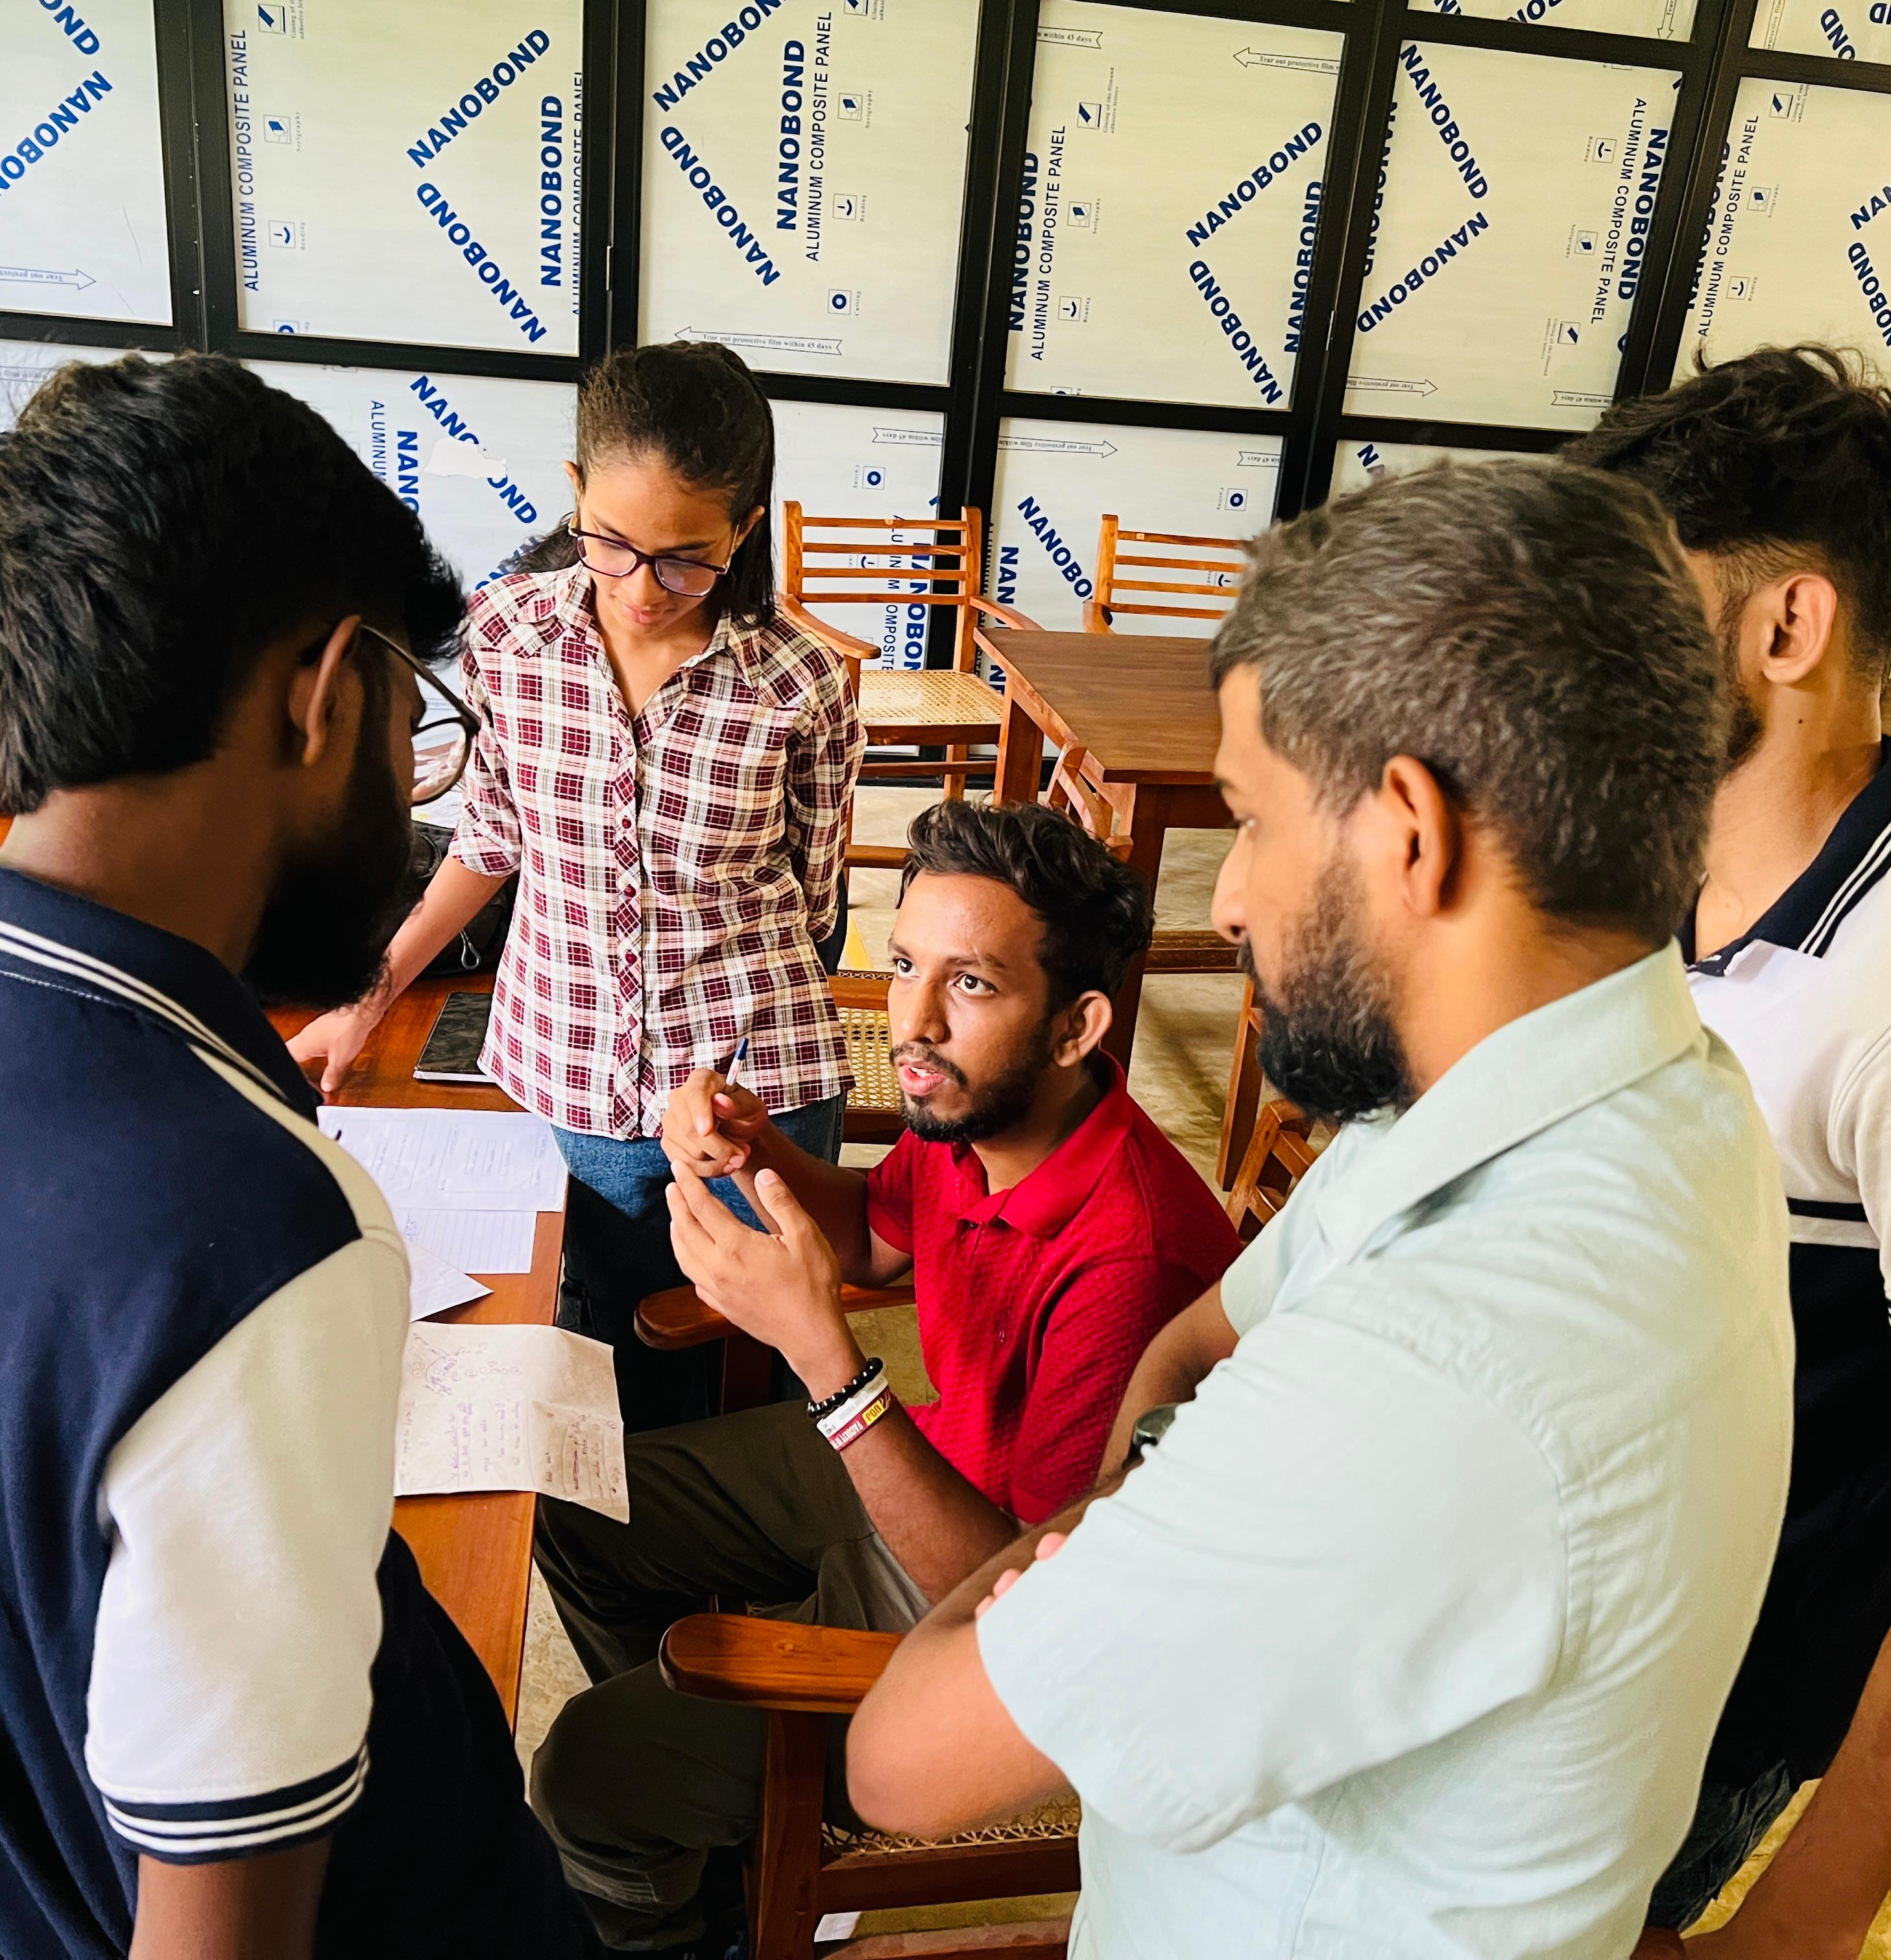
Progress & Future
Current Status & Next Steps
1
Current Status
Scope and requirements confirmed; Figma UI/UX mockups; Use case and NFR questions documented
2
Next Steps
Develop ER diagram & database schema; Connect interfaces to data flow; Begin web implementation & testing plan; Prepare documentation & final demo.

Slide 12
THANK YOU!

